Slide 1
Operating Systems
Lecture # 1
Razi Uddin

Slide 2

GOOGLE Classroom access code
BDS-5A Class Code: q2a4quf
BSE-5A Class Code: agn6jj3
BSE-5B Class Code: 55czht5

Slide 3
Purpose of computer system
Computer systems consist of software and hardware that are combined to provide a tool to implement solutions for specific problems in an efficient manner and to execute programs.
Notes:
So what is a computer? We can not call nay hardware a computer but there are specific requirements that needed to be fulfilled for a system to be called a computer.
Now when we put a software on top of hardware to control its operations through human interaction, this is when a combination of hardware becomes a computer. The main job of computer is to run programs that facilitate the user.

Slide 4
Computer System Organization
Hardware
Operating System
Application Programs
Users
Notes:
So How is a computer system organized in the hierarchy:
Hardware
Device Controllers
Device Driver
Operating System
System Software
Application Software
User This is more of a deep understanding of the pyramid that forms the basics of a computer system.

Slide 5


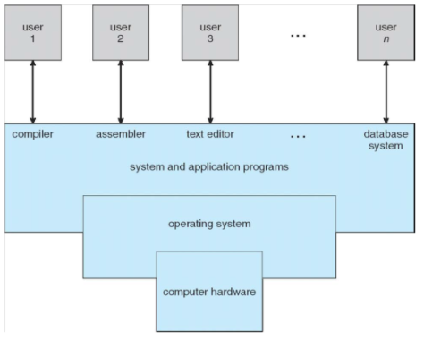

Slide 6
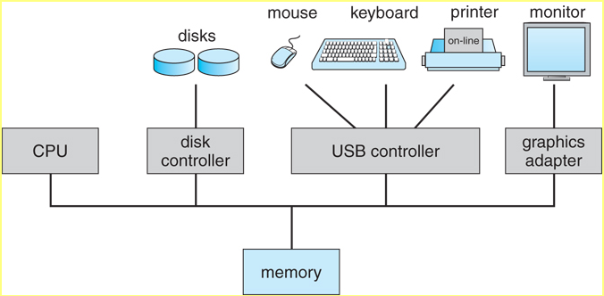
Computer System Organization

Slide 7
The primary purpose of a computer system is to generate executable programs and execute them.
The following are some of the main issues involved in performing these tasks.
Storing an executable on a secondary storage device such as hard disk
Loading executable from disk into the main memory
Setting the CPU state appropriately so that program execution could begin
Creating multiple cooperating processes, synchronizing their access to shared data, and allowing them to communicate with each other
Notes:
These are the steps that are carried out when executing any program in a computer system. So, first of all the program to be executed must be stored in computer’s storage device. Once we know which program to run, we load that program into system memory (RAM) from the secondary storage. Now that a program is ready for execution, we need to load the starting instruction into the processor for execution to begin but before we do that, the CPU state must be set appropriately (kernel or user).
All of these tasks are handled by the operating system and modern operating systems have made our job easier by carrying out multiple tasks in a shared environment. This increases the complexity of the system but results in more advanced systems that can handle much bigger tasks then initially possible.

Slide 8
What is an Operating System
There are two views about this.
The top-down view is that it is a program that acts as an intermediary between a user of a computer and the computer hardware and makes the computer system convenient to use.
The bottom-up view is that it is a program, that allocates and deallocates computer system resources in an efficient fair, and secure manner- A resource manager
A slightly different view of an OS emphasizes the need to control the various I/O devices and programs.

Slide 9
Single-User Systems
Allows only one user to use the computer at a given time.
The goals of such systems are maximizing user convenience and responsiveness, instead of maximizing the utilization of the CPU and peripheral devices.
They can adopt technology developed for larger operating systems.
Often individuals have sole use of computers and do not need advanced CPU utilization and hardware protection features.
They may run different types of operating systems, including DOS, Windows, and MacOS. Linux and UNIX operating systems can also be run in single-user mode
Notes:
These are the modern day personal computer systems. Here the priority is to carry out user tasks and not utilizing the full I/O potential or processor load. A major example is smartphones where only the tasks required by the user are performed and all other background tasks are kept to a minimum.
These systems do not need excessive hardware resources to carry out tasks as they are usually used in less complex environments, same like a laptop or smartphone where tasks and system load are usually smaller compared to that of servers or large distributed systems.
Similarly we do not expect user to dig deeper and access the areas of systems usually left to the professionals. The user here needs the task to be done rather than knowing how the task is done, so this form of information is usually hidden from the users.

Slide 10
Batch Systems
Early computers were large machines run from a console with card readers and tape drives as input devices and line printers, tape drives, and card punches as output devices.
User did not interact directly with the system; instead the user prepared a job, which consisted of the program, data, and some control information about the nature of the job.
The job was in the form of punch cards, and at some later time the output was generated by the system.
Output=> result of the program + dump of the final memory and register contents for debugging

Slide 11
Batch Systems
To speed up processing, operators batched together jobs with similar needs and ran them through the computer as a group. For example, all FORTRAN programs were compiled one after the other.
The major task of such an operating system was to transfer control automatically from one job to the next.
The CPU is often idle because the speeds of the mechanical I/O devices such as a tape drive are slower than that of electronic devices.
Digital Equipment Corporation’s VMS is an example of a batch operating system.

Slide 12
Multi-programmed Systems
Increases CPU utilization by organizing jobs so that the CPU always has one to execute.
The operating system keeps several jobs in memory simultaneously.
Since the number of jobs that can be kept simultaneously in memory is usually much smaller than the number of jobs that can be in the job pool.
The operating system picks and executes one of the jobs in the memory.
The job has to wait for some task such as an I/O operation to complete.
In a non-multi-programmed system, the CPU would sit idle.
In a multi-programmed system, the operating system simply switches to, and executes another job.
Notes:
Modern day server systems, where resources are shared among many users or systems being used in industrial applications. Here the major requirement is to complete as much jobs as possible due to high running costs of these systems. So, it is more beneficial to execute a pool of jobs while system is running rather than firing up the system each time a job needs processing. However this may not be the case as these systems are usually designed and required by large computation environments and downtime is usually kept at a minimum.

Slide 13
Time-sharing systems
Multi-user, multi-process, and interactive system.
Allows multiple users to use the computer simultaneously.
A user can run one or more processes at the same time and interact with his/her processes.
A time-shared system uses multiprogramming and CPU scheduling to provide each user with a small portion of a time-shared computer.
Each user has at least one separate program in memory.
To obtain a reasonable response time, jobs may have to be swapped in and out of the main memory.
UNIX, Linux, Windows NT Server, and Windows 2000 server are timesharing systems.
Notes:
Client-server architecture is the major example where each system may handle multiple requests and allocate resources based in user’s needs.

Slide 14
Real time systems
A real-time system has well-defined, fixed time constraints, and if the system does not produce output for input within the time constraints, the system will fail.
Real time systems come in two flavors: hard and soft.
A hard real-time system guarantees that critical tasks be completed on time.
A less restrictive type of real-time system is a soft real-time system, where a critical real-time task gets priority over other tasks, and retains that priority until it completes.
Example: Systems that control scientific experiments, medical imaging systems, industrial control systems, and certain display systems.

Slide 15
hard real-time system
Requires that all delays in the system be completed on time.
This goal requires that all delays in the system be bounded.
Secondary storage of any sort is usually limited or missing, with data instead of being stored in short-term memory or in read-only memory.
Most advanced operating system features are absent too.

Slide 16
Soft real-time system
Where a critical real-time task gets priority over other tasks, and retains that priority until it completes.
As in hard real-time systems, the operating system kernel delays need to be bounded.
Soft real-time is an achievable goal that can be mixed with other types of systems,
Whereas hard real-time systems conflict with the operation of other systems such as time-sharing systems, the two cannot be mixed.
Notes:
Every system nowadays is some form of real time system where usually the system is executed as a soft real time system in usual state but may switch to a hard real time system when a need arises. A major example is the computer system, where it may carry out tasks as a soft system normally but in case of some form of system failure, the system may switch to acting as a hard real time system to protect user and computer’s resources.

